Slide 1
Hash Functions
Variable Length
Message
are used to generate fixed-length fingerprints of arbitrarily large messages
denoted as H(M)
  M is a variable length message
  H is the hash function
  H(M) is of fixed length
  H(M) calculations should be easy and fast
    indeed they are even faster than symmetric ciphers
H
(Hash Func.)
Hash
H(M)
Fixed Length

Slide 2
Hash functions – Requirements and Security
Hash function should be a one-way function
  given h, it is computationally infeasible to find x such that
  h = H(x)
  complexity of finding x out of h is 2^{n}, where n is the number of bits in the hash output
  Called one-way property (a.k.a. preimage resistance)
Weak collision resistance (a.k.a. second preimage resistance)
  given x, it is computationally infeasible to find y with
  H(x) = H(y)
  complexity of attack is 2^{n}
(Strong) collision resistance
  It is computationally infeasible to find any pair x, y such that H(x) = H(y)
  complexity is 2^{n/2}

Slide 3
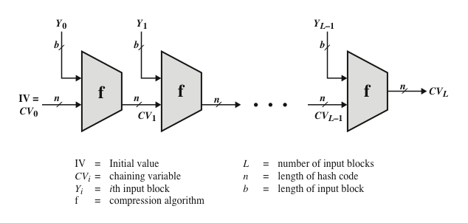
Hash function – General idea
Iterated hash function idea by Ralph Merkle
  a sequence of compressions
  if the compression function is collision-free, so is the hash function
  MD5, SHA-1, SHA-2 and some others are based on that idea

Slide 4
Important Hash Functions
MD5
  Message Digest 5
  another Ron Rivest contribution
  arbitrarily long input message
    block size is 512 bits
  128-bit hash value
has been used extensively, but its importance is diminishing
  brute force attacks
    2⁶⁴ is not considered secure complexity any more
  cryptanalytic attacks are reported

Slide 5
Important Hash Functions
SHA-1
  Secure Hash Algorithm – 1
  NIST standard
    FIPS PUB 180-1
  input size < 2⁶⁴ bits
  hash value size 160 bits
    brute force attacks are not so probable
      2⁸⁰ is not-a-bad complexity
  A Crypto 2005 paper explains an attack against strong collision with 2^69 complexity
    have raised concerns on its use in future applications
  Later several other attacks are reported (some of them are partial attaks)
  Eventually a practical attack is reported by the team at CWI Amsterdam and Google (approx. 2^63 complexity)
    Paper at https://marc-stevens.nl/research/papers/SBKAM17-SHAttered.pdf
    Link https://shattered.io/
Notes:
In 2005, a research team described an attack in which two separate messages could be found that deliver the same SHA-1 hash using 2^69 operations, far fewer than the 2^80 operations previously thought needed to find a collision with an SHA-1 hash [http://people.csail.mit.edu/yiqun/SHA1AttackProceedingVersion.pdf]. This result should hasten the transition to newer, longer versions of SHA.
Taken from http://en.wikipedia.org/wiki/SHA_hash_functions on Oct. 11, 2009.
"Cameron McDonald, Philip Hawkes and Josef Pieprzyk presented a hash collision attack with claimed complexity 2^52 at the Rump session of Eurocrypt 2009. However, the accompanying paper, "Differential Path for SHA-1 with complexity O(2^{52})" has been withdrawn due to the authors' discovery that their estimate was incorrect."

Slide 6
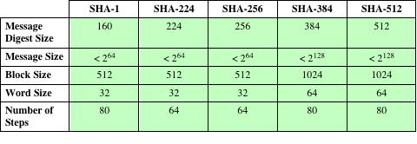
Important Hash Functions
However, NIST had already (in 2002) published FIPS 180-2 to standardize (SHA-2 family)
  SHA-256, SHA-384 and SHA-512
  for compatible security with AES
  structure & detail is similar to SHA-1
  but security levels are rather higher
  224 bit (SHA-224) is later added in 2008 as FIPS 180-3
SHA-2
Note: All sizes are measured in bits.

Slide 7
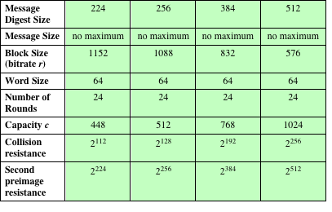
Important Hash Functions
SHA-3
  In 2007, NIST announced a competition for the SHA-3, next generation NIST hash function
  Winning design was announced by NIST in October 2, 2012
  The winner is Keccak by by Guido Bertoni, Joan Daemen, Michaël Peeters, and Gilles Van Assche
  Different design principles than other SHAs
    Called Sponge construction
  However, standardization process is delayed (standard has been published on August 5, 2015)
  There had been controversies (read the wikipedia page of SHA-3)
  I am not sure if it is going to replace SHA-2
Notes:
SHA3 has been selected by NIST(October 2, 2012: The winner is Keccak by by Guido Bertoni, Joan Daemen, Michaël Peeters, and Gilles Van Assche)

Slide 8
Digital Signatures
Mechanism for non-repudiation
Basic idea
  use private key on the message to generate a piece of information that can be generated only by yourself
    because you are the only person who knows your private key
  public key can be used to verify the signature
    so everybody can verify
Generally signatures are created and verified over the hash of the message
  Why?

Slide 9
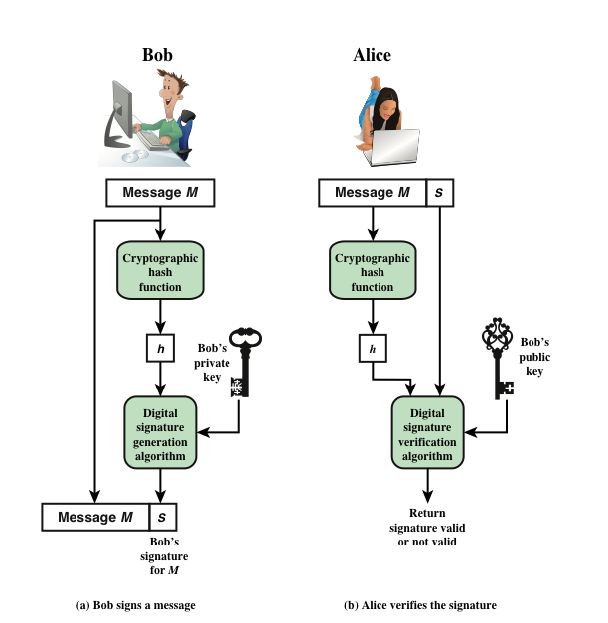
Generic Digital Signature Model
Notes:
Generic model of the process of making and using digital signatures.
Suppose that Bob wants to send a message to Alice. Although it is not
important that the message be kept secret, he wants Alice to be certain that the
message is indeed from him. For this purpose, Bob uses a secure hash function, such
as SHA-512, to generate a hash value for the message. That hash value, together
with Bob’s private key serves as input to a digital signature generation algorithm,
which produces a short block that functions as a digital signature . Bob sends the
message with the signature attached.
When Alice receives the message plus signature,
she (1) calculates a hash value for the message; (2) provides the hash value and
Bob’s public key as inputs to a digital signature verification algorithm. If the algorithm
returns the result that the signature is valid, Alice is assured that the message
must have been signed by Bob. No one else has Bob’s private key and therefore no
one else could have created a signature that could be verified for this message with
Bob’s public key. In addition, it is impossible to alter the message without access to
Bob’s private key, so the message is authenticated both in terms of source and in
terms of data integrity.

Slide 10
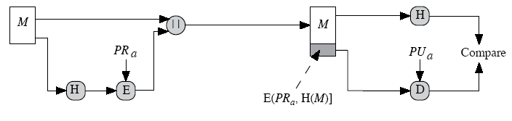
Digital Signature – RSA approach
M: message to be signed H: Hash function
E: RSA Private Key Operation PR_{a}: Sender’s Private Key
D: RSA Public Key Operation PU_{a}: Sender’s Public Key
E [PR_{a},H(M)] Signature of A over M

Slide 11
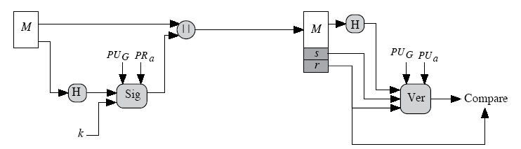
Digital Signature – DSA approach
DSA: Digital Signature Algorithm
  NIST standard - FIPS 186 - current revision is 186-4 (2013)
  Key limit 512 – 1024 bits, only for signature, no encryption
    Starting186-3, increased up to 3072
  based on discrete logarithm problem
  Message hash is not restored for verification (difference from RSA)
s, r
M: message to be signed H: Hash function
Sig: DSA Signing Operation PR_{a}: Sender’s Private Key
Ver: DSA Verification Operation PU_{a}: Sender’s Public Key
s, r Sender’s signature over M PU_{G}: Global Public Key components

Slide 12
Collision resistant hash functions and digital signatures
Have you seen the reason why hash functions should be collision resistant?
  because otherwise messages would be changed without changing the hash value used in signature and verification

Slide 13
Collision resistant hash functions and digital signatures
Birthday attack
  generate two messages
    one with legitimate meaning
    one fraudulent
  create a set of messages from each of them that carries the same meaning
    play with blanks, synonyms, punctuations
  calculate the hashes of those two sets
  you should have 2^{n/2} messages (and hashes) in each set for 0.63 probability of a match, where n is the hash size
  if a match is found, then the fraudulent hash could be replaced with the legitimate one without affecting the signature

Slide 14
Elliptic Curve Cryptography
Based on the difficulty of Elliptic Curve Discrete Logarithm problem
  details are not in the scope of this course
  a concise description is in Sections 10.3 and 10.4 of Stallings
Actually a set of cryptosystems
  each elliptic curve is one cryptosystem
    160-bit, 163-bit, 233-bit, … defined in IEEE P1363 standard
Key size is smaller than RSA
  160-bit ECC is almost has the security as 1024 bit RSA
Private Key operation is faster than RSA, public key operation is almost equal

Slide 15
Elliptic Curve Cryptography
Key exchange
  ECDH
    Elliptic Curve Diffie-Hellman
Digital Signatures
  ECDSA
    Elliptic Curve Digital Signature Algorithm
ECDH and ECDSA are standard methods
Encryption/Decryption with ECC is possible, but not common

Slide 16
Message Authentication
Making sure of
  message has been sent by the alleged sender
  message has been received intact
    no modification
    no insertion
    no deletion
  i.e., Message Authentication also covers integrity
Digital Signatures
  provides integrity + authentication + nonrepudiation
We will see mechanisms that provide authentication, but not non-repudiation

Slide 17
Mechanisms for
Message Authentication
General idea
  receiver makes sure that the sender knows a secret shared between them
  in other words, sender demonstrates knowledge of that shared secret
  without revealing the shared secret to unauthorized parties of course
We will see some mechanisms for this purpose

Slide 18
Mechanisms for
Message Authentication
Message Encryption
  provides message authentication, but …
Message Authentication Code Functions
  similar to encryption functions, but not necessarily reversible
  Generally Hash based MAC is used (will see)
Actually hash functions are used for message authentication in several ways (will see)

Slide 19
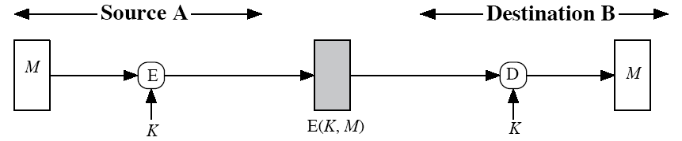
Using Message Encryption for Authentication
Provides encryption. What about authentication?
  yes, but there must be a mechanism to detect the restored M is the same as the sent M
    intelligible restored plaintext (may be difficult)
    error control codes (checksum), see next slide

Slide 20
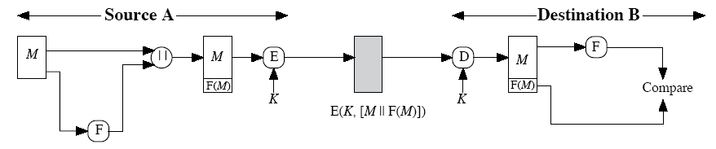
Using Message Encryption for Authentication
Addition of FCS (frame check sequence) helps to detect if both M’s are the same or not
F: FCS function

Slide 21
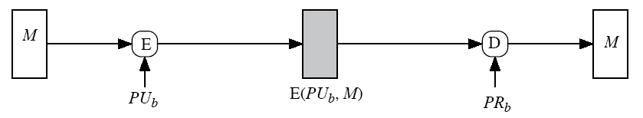
Using Message Encryption for Authentication
What about public-key encryption?
Provides confidentiality, but not authentication
  Why?
  What should be done for authentication using public-key crypto?
  we have seen the answer before.

Slide 22
Message Authentication Code (MAC) and MAC Functions
An alternative technique that uses a secret key to generate a small fixed-size block of data
  based on the message
  not necessarily reversible
  secret key is shared between sender and receiver
  called cryptographic checksum or MAC (message authentication code)
appended to message
receiver performs same computation on message and checks if matches the received MAC
provides assurance that message is unaltered and comes from sender

Slide 23
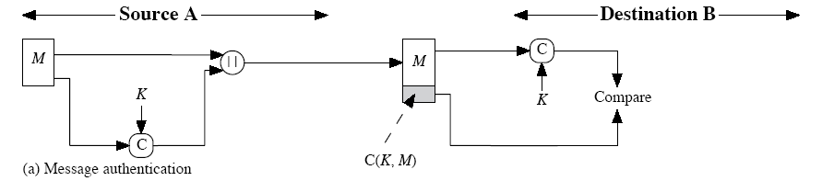
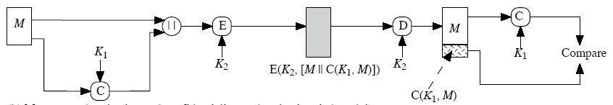
MAC
Only authentication
C: MAC function
Authentication and confidentiality

Slide 24
MAC – The Basic Question
Is MAC a signature?
  No, because the receiver can also generate it

Slide 25
Hash based Message Authentication
Hash Functions
  condenses arbitrary messages into fixed size
We can use hash functions in authentication and digital signatures
  with or without confidentiality

Slide 26
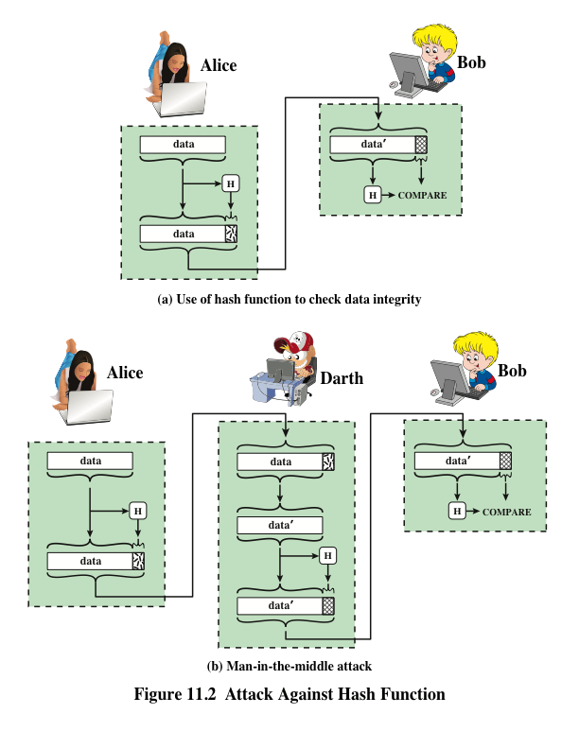
Can we just use hash function for integrity?

Slide 27
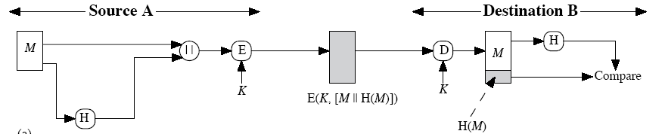
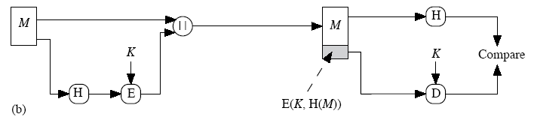
Hash based message authentication using symmetric encryption
with confidentiality
without confidentiality

Slide 28
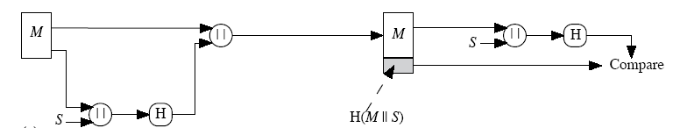
Other Hash based message authentication techniques
Authentication is based on a shared-secret s, but no encryption function is employed

Slide 29
Keyed Hash Functions
it is better to have a MAC using a hash function rather than a block cipher
  because hash functions are generally faster
  not limited by export controls unlike block ciphers
hash functions are not designed to work with a key
Solution: hash includes a key along with the message
original proposal:
  KeyedHash = Hash(Key || Message)
  by Gene Tsudik (1992)
eventually led to development of HMAC
  by Bellare, Kanetti and Krawczyk

Slide 30
HMAC
specified as Internet standard RFC2104
  used in several products and standards including IPSec and SSL
uses hash function on the message:
  HMAC_{K} = Hash[(K⁺ XOR opad) ||
  Hash[(K⁺ XOR ipad)|| M)]]
where K⁺ is the key padded out to block size of the hash function
and opad, ipad are some padding constants
overhead is just 3 more blocks of hash calculations than the message needs alone
any hash function (MD5, SHA-1, …) can be used

Slide 31
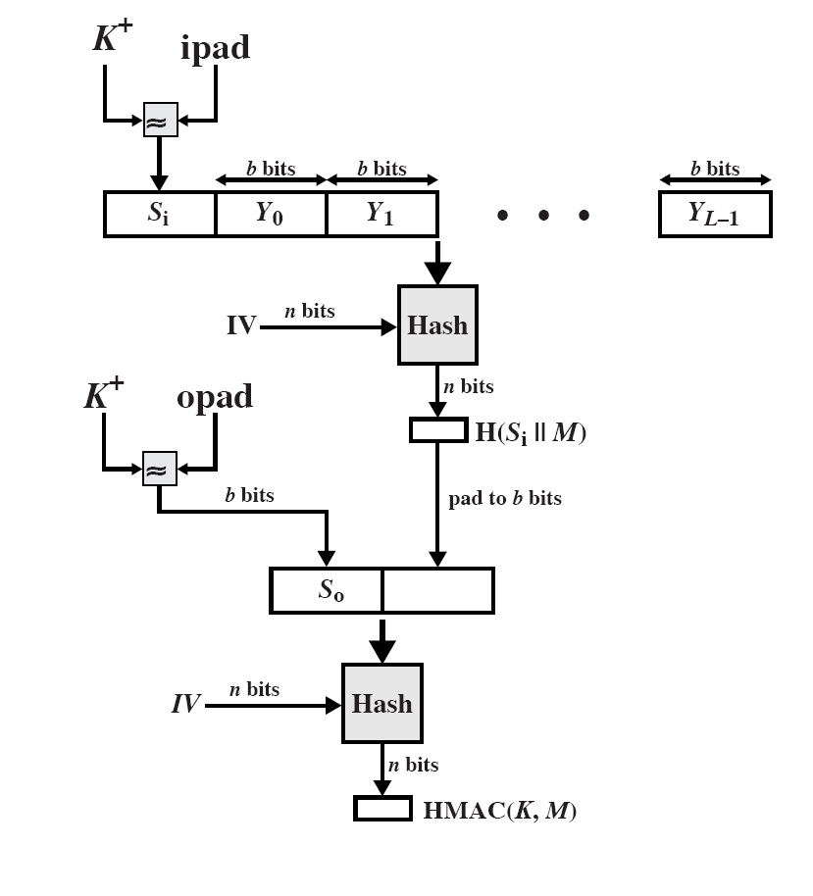
HMAC structure

Slide 32
HMAC Security
HMAC assumes a secure hash function
  as their creators said
    “you cannot produce good wine using bad grapes”
it has been proved that attacking HMAC is equivalent the following attacks on the underlying hash function
  brute force attack on key used
  birthday attack
    find M and M’ such that their hashes are the same
    since keyed, attacker would need to observe a very large (2^{n/2} messages) number of messages that makes the attacks infeasible
    Let’s discuss if MD5-based HMAC is secure.

Slide 33
Message Encryption
Public key encryption for the bulk message is too costly
  bulk encryption should be done using symmetric (conventional) crypto
If a key is mutually known (e.g. if D-H is used)
  use it to encrypt data
  this method is useful for connection oriented data transfers where the same key is used for several data blocks
If no key is established before
  mostly for connectionless services (such as e-mail transfer)
  best method is enveloping mechanism

Slide 34
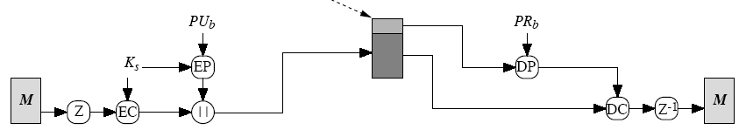
Digital Envelopes
A randomly chosen one-time symmetric encryption key is encrypted with public key of the recipient
fast en/decryption without pre-establishment of keys
EC: Conventional Encryption DC: Conventional Decryption
EP: Public-key Encryption DP: Public-key Decryption
Ks: Session key (one-time)

Slide 35
What we have covered and will cover next?
Symmetric Cryptography
Asymmetric (Public-key) Cryptography
  including D-H key agreement
Hash functions
Digital Signatures using PKC
Message Authentication Mechanisms
  MACs, HMAC
After that we will continue with Key Distribution/Management and Authentication
  they are closely related with each other

